Slide 1
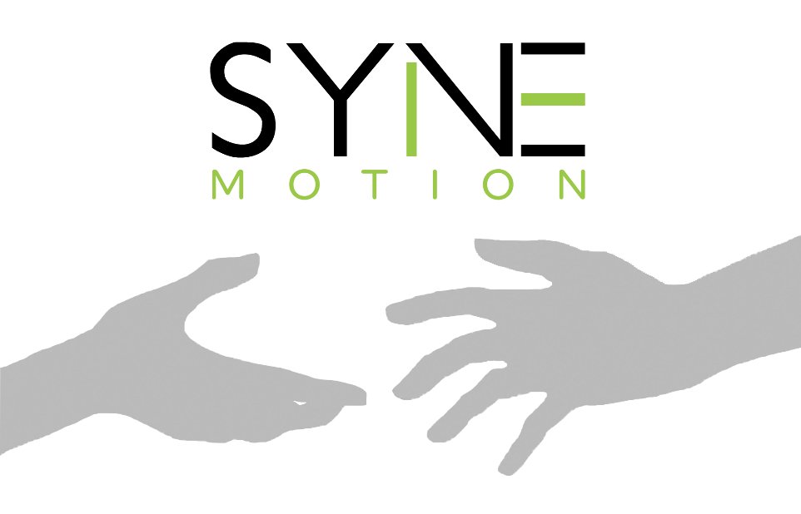
Breaking communication barriers

Slide 2
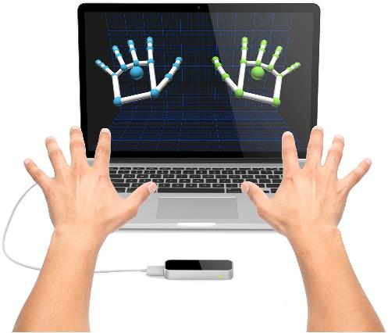
What is Syne?
Syne Motion is an interactive sign language learning app that uses Leap Motion

Slide 3
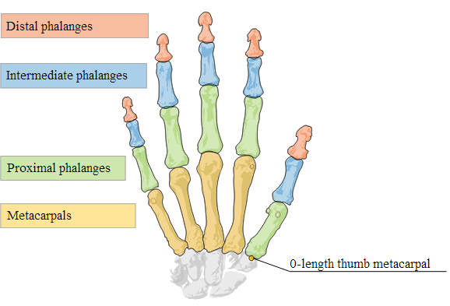
The mechanics
Syne Motion allows you to learn to sign the alphabet
Gesture generator allows the user to record and store their own gestures
Uses direction vectors to track the direction of each bone in the hand
Data processing using CSV reader an writer to track the (x,y,z) coordinates in space

Slide 4
